Slide 1

PMMAI SEMINAR HYDERABAD
MIFA SYSTEMS PVT. LTD.
WELCOMES
YOU
ALL
Modern Controls – Abhay Upadhye
au@mifasystems.com

Slide 2
Making Life Easy
Through
Modern Controls...
MIFA SYSTEMS PVT. Ltd.
Your reliable partner for Automation Solutions

Slide 3
What is a controller?
They are modern days interpreters between Man and Machines…..
What you expect from a good controller?
The truth is ……….Every thing under the sun
The new breed of smart controller….. It can control, it can communicate, it can
give facts & figures, it can give E-Mail or SMS, it can give warnings…..
You want it to do everything with it now………Right?!!!!.......

Slide 4

Making Life Easy Through Modern Controls
MIFA SYSTEMS
Is your life difficult through wrong / existing out dated Control Selection?
Make Life Easier with right controls – Modern Controls
Ask the Correct Control for better Tomorrow

Slide 5

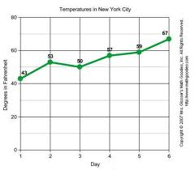
Making Life Easy Through Modern Controls
“Control”
Taking a decision.
Which enhances your productivity and profitability…
Define the need of system.
Check the best possible solutions
Right implementation

Slide 6

What one should look for in better control solutions?
  Safety..(Always Top most priority)
  Should be user friendly even for complex controls
  Should be Versatile to do better Multi Tasking
  The Quick UP - time through remote maintenance
  Alarm for Preventive Maintenance
  Improving the Machine Life through Artificial Intelligence
  Keeping history of control changes etc…
  To Get
  Good Quality & Consistent Production
  &
  Best Returns

Slide 7
KePlast
The optimized automation solution
for injection molding machines

Slide 8
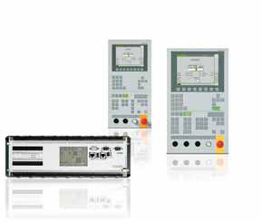
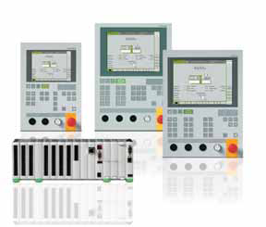
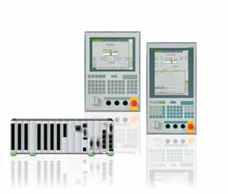
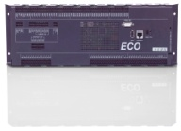
KePlast – Product range
KePlast i1000 / i1000 ECO
KePlast i2000
KePlast i2000
KePlast i5000
Optimized economy solution for standard machines
Flexible all-rounder with high comfort user interface
Power-pack with top performance and flexibility
Cost optimized for standard hydraulic injection machines
European quality
Extreme compact single borad controller
Hostcomputer via Ethernet
CAN for Servo Systems
7“, 8“ & 10“ Non Touch DIsp
For hydraulic, hybride, and full electric machines
Seamless integration of KeDrive servos
High comfort touch-screen operation
Extensive production quality package
10“, 12“ & 15“ Touch Displays
Modular, dezentralized I/O configuration for large machines
Multi-component application
12“ & 15“ Touch Display
Notes:
We have heard a lot about features and highlights of KePlast, our optimized automation solution specially designed for injection molding machines. Now let me show you how we put together this set of special features into packages easy to use for your different machines and applications.
KePlast serves the entire range of injection molding machines. From standard hydraulic machines for general purpose applications up to solutions for special machines in the high-end segment. Hydraulic, hybride or full electric machines – different machines – different requirements – different KePlast automation solutions. Generally we define three product lines, named KePlast i1000, i2000 and i5000.
<click>
KePlast i1000 is the cost optimized solution for standard hydraulic injection machines, specially designed for demands of high volume markets like mainland China. It gives you best European quality in shape of an extreme compact single board controller in robust design and operator panels with key operation, as this still has better market acceptance in China than touch-screen. Even the economy model KePlast i1000 has typical KePlast interfaces like USB or Ethernet on board and can therefor be hooked up to host computer systems.
<click>
KePlast i2000, our mid-class-system, is the flexible mutli-talent for machines when high comfort touch-screen operation is required. It opens the door to hybride and full electric machines. By direct-plug the compact controller module can be extended with additional I/O modules easily. An extensive package of screens for production quality supervision and control as well as special screens for setup and maintenance complete KePlast i2000.
<click>
The top level KePlast system is KePlast i5000. Highest CPU performance enables fastest closed loop cycles down to 500us and switch-over detection of 100us. KePlast i5000 is the optimum solution for multi-component machines with flexible machine sequences or large machines with modular, dezentralized I/O configruation.

Slide 9
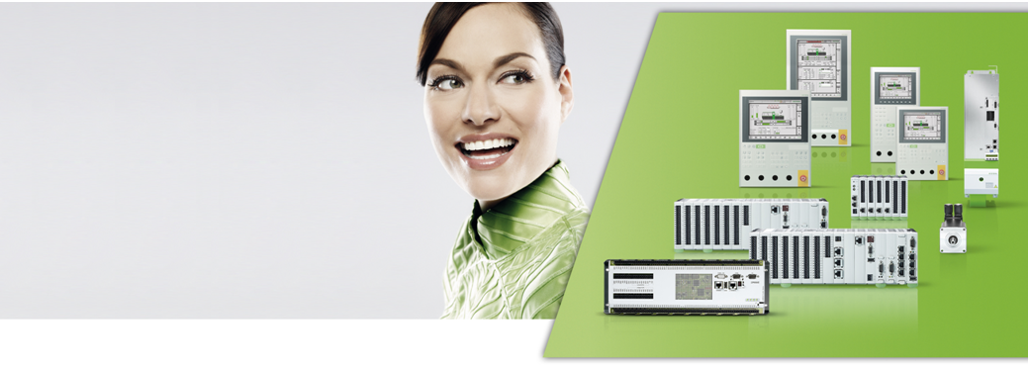
KePlast Easy Mould

Slide 10
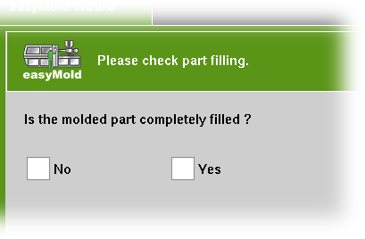
KePlast EasyMold – Mold setup assistent
The problem:
setup a new mold is complex and time consuming
needs expert know-how
The solution: KePlast EasyMold
No expert know-how needed
  less training
  everyone in staff can do
Better setup quality
  always valid, reproducible parameters of uniform quality
Time saving
  get production parameters on fastest track
  automatic detect of plasticise stroke
  Just answer simple questions, give yes or no and finish...
  The product is ready in final form
… everyone can setup a new mold
Notes:
The mold setup assistent KePlast EasyMold takes care about a typical problem of injection machine operation:
The injection process is quite complex. Many different ways, depending on the person doing the mold setup may lead to different results. Finding stable processing parameters needs many trials, usually you need experts with long-term experience to solve this.
<click>
KePlast EasyMold makes it simple. The expert know-how is just integrated directly into the control, so a standard machine operator can do this complex work now. KePlast EasyMold saves time and results in better reproducible setup quality. Molding parameter quality no longer depends on different setup personnel.

Slide 11
KePlast EasyNet 2.0

Slide 12

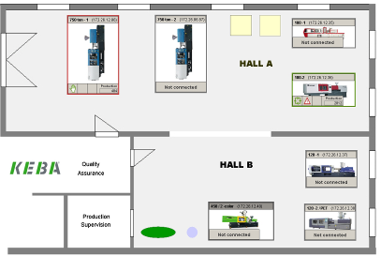
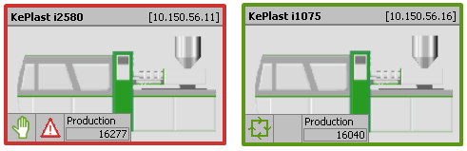
KePlast EasyNet – Factory Floor Plan
Production status at a glance
  Realistic floor plan with machine pictures
  Grafical editor for production hall
  Management of multiple factory halls
Machine status overview
  Notification on pending alarms
  See the machine operation mode
  Production counter
… see what is happening in your plant

Slide 13
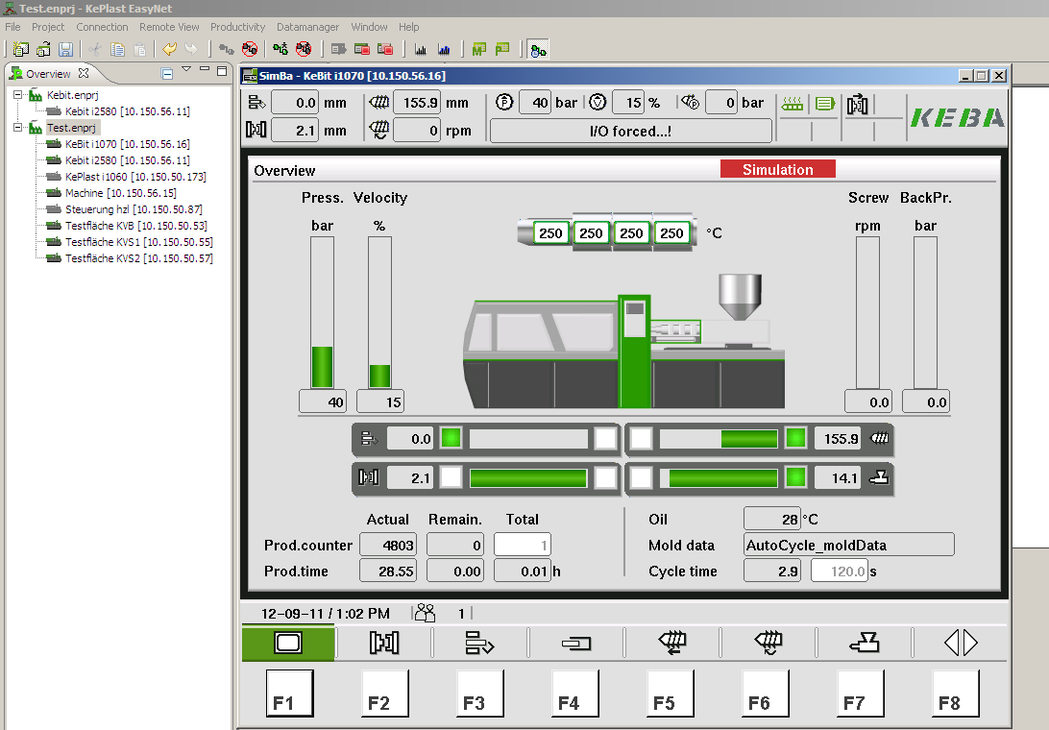
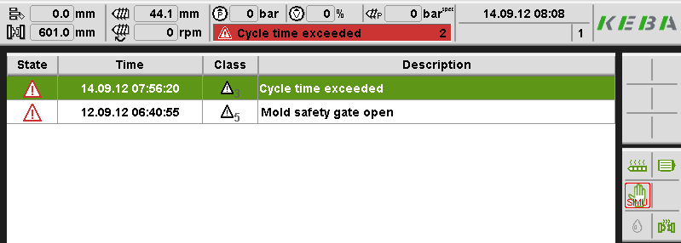
KePlast EasyNet – Remote Machine Screens
Full access to machine screens
  All machine screens
  Different Screen on Machine and Remote.
  Easy to operate – less training
  Limitation in access – no movement
Monitor machine history
  Check reason for machine stand still
  Infolog – Monitor user activities
… have a detailled look in the machine

Slide 14
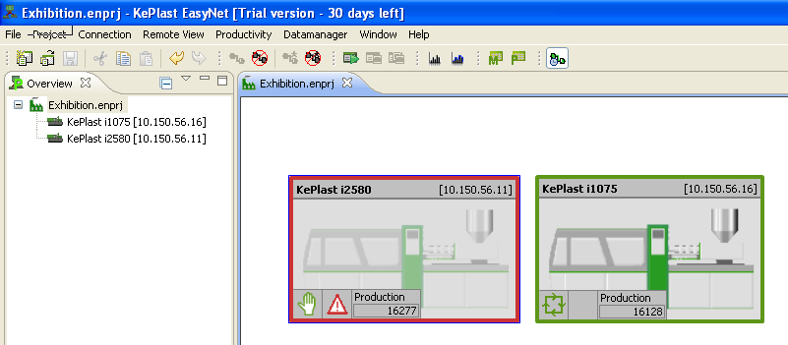
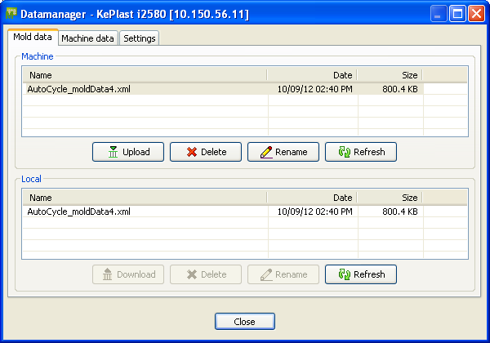
KePlast EasyNet – Data Manager
Centralized management of machine data
  Save mold data after process changes
  Transfer from one machine to another easily
  Improve quality documentation
Data management
  Upload / Download mold data
  SPC – upload process quality data
  Save data on host PC or server
... more convenience and data security

Slide 15
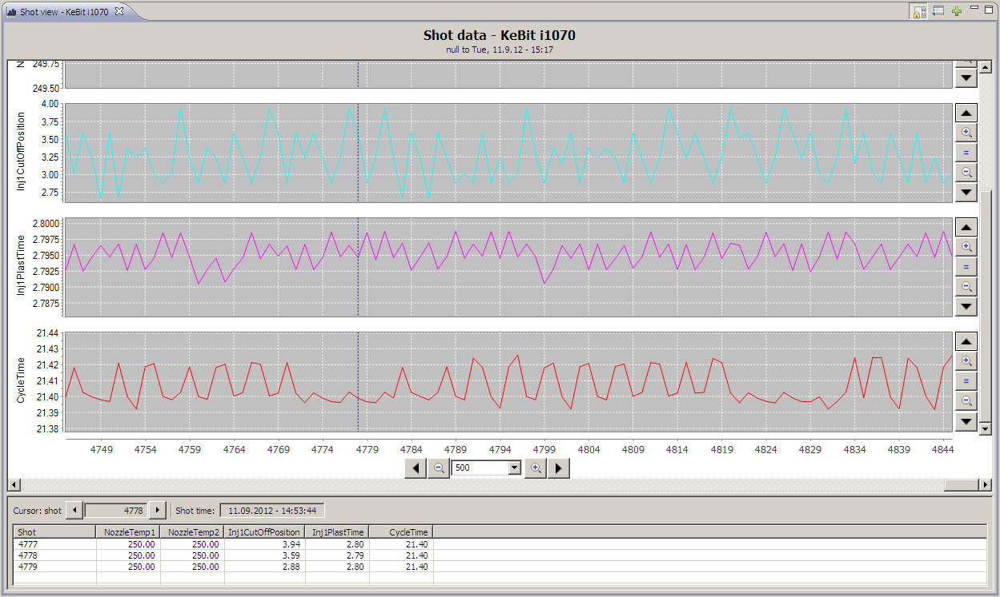
KePlast EasyNet – Quality Data Monitor
Effective monitoring of quality parameters
  Convenient grafical view of each shot
  Out of range detection and cursor function
  Free selection and naming of parameters
Monitor and optimize process quality
  Historical storage in databank on host PC
  Export of all parameters for offline analyzis
  Offline analyzis via Excel by CSV format
... a graphic is worth a 1000 values

Slide 16
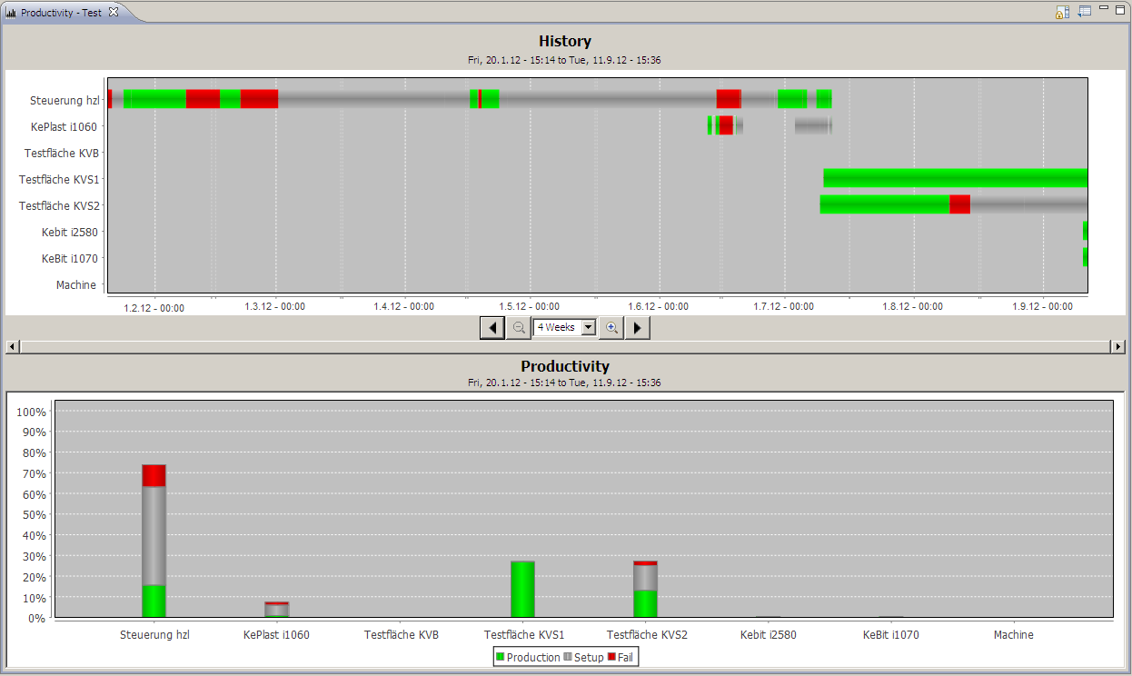
KePlast EasyNet – Productivity Monitor
Productivity of your machines at a glance
  Timeline overview of production and standstill
  Intuitive comparison of machine productivity
  Clear overview by bar graphs
Monitor and optimize productivity
  Historical storage in databank on host PC
  Export of productivity data for offline analysis
  Offline analysis via Excel by CSV format
... optimize your productivity

Slide 17
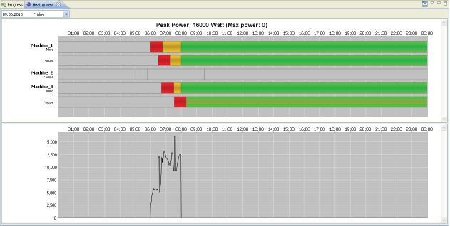
KePlast EasyNet – Heatup Management
Optimized production startup management
  Machine heatup controlled by EasyNet
  Cost reduction by balanced energy consumption by peak power limitation
  Machines ready for production by week timer
  Energy graph collecting the heating power consumption of the plant
... reduce your energy costs

Slide 18
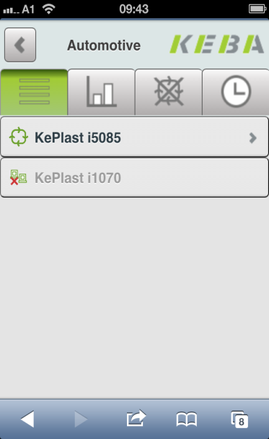
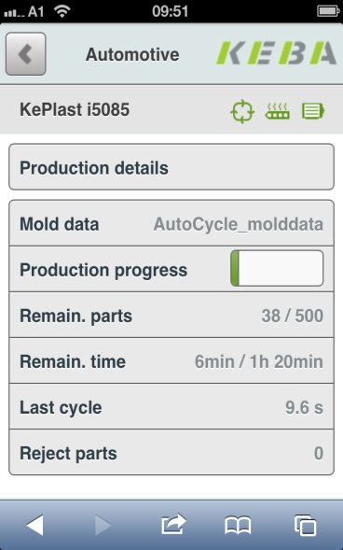

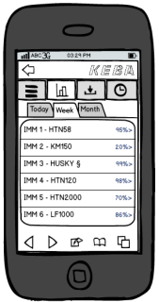
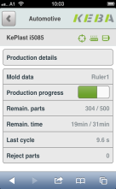

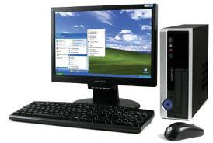

KePlast EasyNet.Mobile – SmartPhone
Solution for Smartphone
  Smartphone connected via WiFi to EasyNet
  Plant and machine information in your hand
  Smartphone independend by explorer
See what you need
  Plant manager: Productivity overview
  Service technician: Events for service and production change
  Get informed via E-Mail
EasyNet
Webserver
Plant
Wifi Router
... always be informed

Slide 19
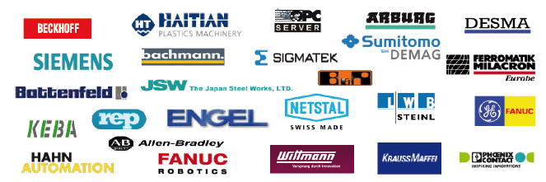
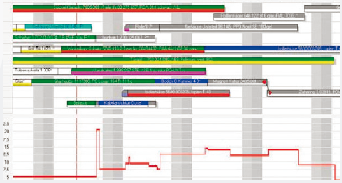
KePlast T.I.G – High End Factory Host System
Plant Overlapping Monitoring
  Keep more plants under control
  Summary of worldwide production
T.I.G. Modules
  Monitoring Assistant – Display machine productivity
  Planning Assistant – Grafical planning board
  Quality Assistant – Display trends and reject rates
  Setup Assistant – Up- and download setting data
  Maintenance Assistant – Schedule maintenance work
… production planning at highest level

Slide 20
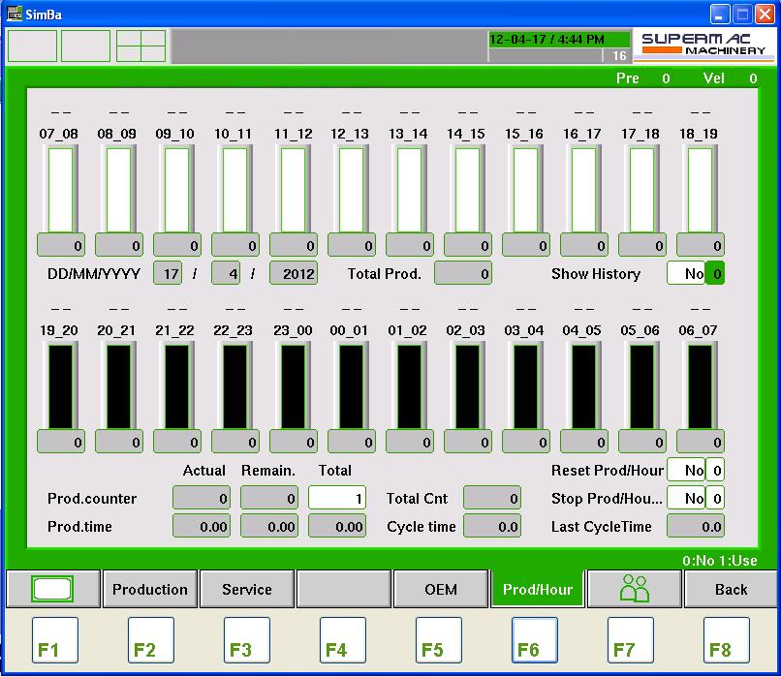
Production Data on Controller

Slide 21
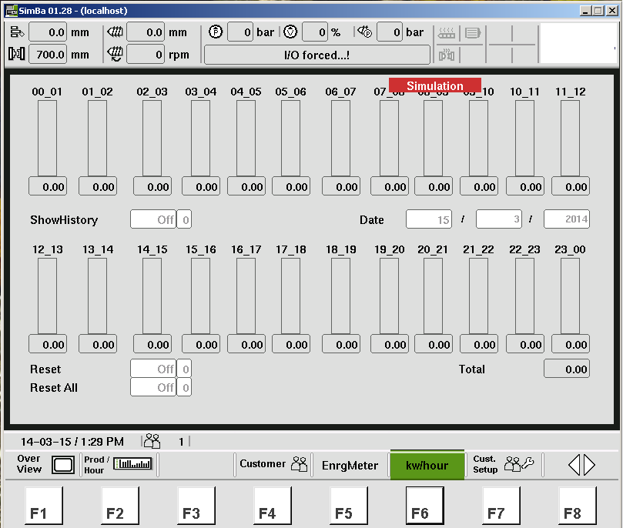
Energy Report

Slide 22
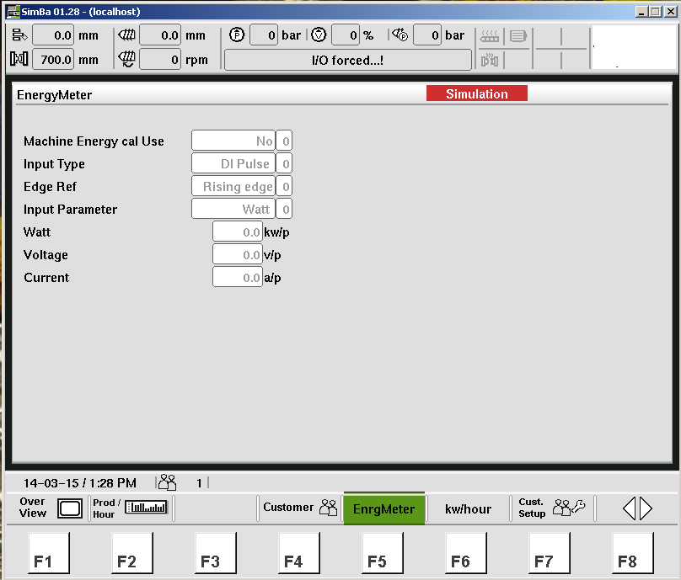
Energy Mask

Slide 23
KePlast ServiceNet
Worldwide Remote Service

Slide 24
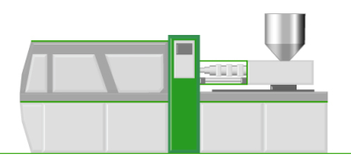
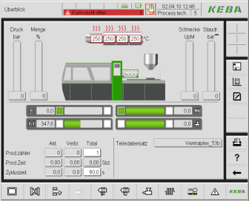






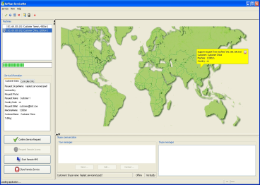



KePlast ServiceNet – In Seconds at the Machine
Remote HMI
3G
com
Service
Center
3G
com
Audio / Video communication
Online chat
Screen transfer
Service history server

Slide 25
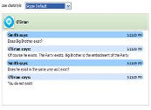


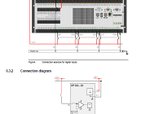




KePlast ServiceNet – Smartphone client
Online chat
Audio communication
Video communication
follow parameter changes on HMI screens
Additional service documents, drawings, ...
iPhone
Android
Pictures or videos from webcam

Slide 26
KePlast – your benefits
Tailor made control solutions optimized for injection molding machines
  best price-performance ratio by IMM specific hardware design
  easy customizing to your request
Scalable hardware is running one software
  from economy to highest end
  for hydraulic, hybrid and full electric machines
Best injection process technology – easy to use
  innovative KePlast software assistents for mold setup and software build
Professional partner in engineering and support
  turn-key solutions or flexible customizing supported by state-of-the-art tools
  best competence from consulting to after sales service
  more than 20 years of experience in injection molding controls
Notes:
I hope I could give you many interesting informations about the KePlast concepts and products. Let me summarize, how KePlast can be a key for your market andvantage.
<click>
KePlast is tailor made for injection molding machines, no overhead costs or work-around solutions.
<click>
With KePlast you have one solution provider for all kinds of injection machines. From economy to high end, from hydraulic to full electric – one software concept and optimum hardware performance in all cases.
<click>
KePlast is not only a machine control. Innovative software assistents make best injection process technology easy to use for everyone.
<click>
And last but not least, KePlast is your professional partner in all fields of engineering and support. Whether you are looking for a turn-key solution or you need flexible customizing, let the KePlast team satisfy you with competence in our professional solutions. More than 20 years of experience in injection molding control provides confidence.

Slide 27
Your reliable partner in Automation
MIFA SYSTEMS PVT. LTD.
Complete Extrusion Monitoring system
The right solution for your plant

Slide 28
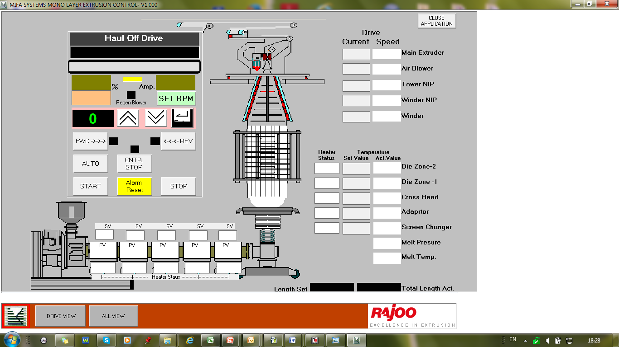

Slide 29
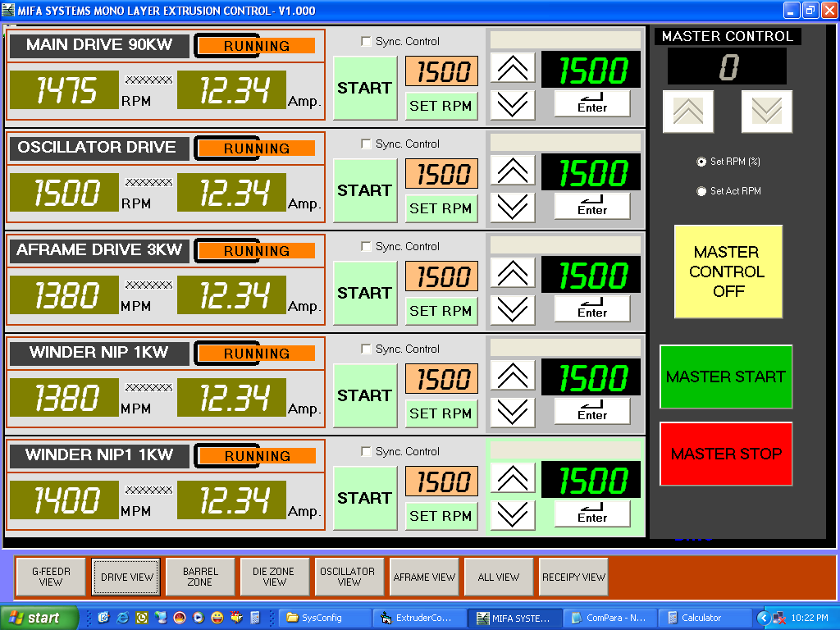
Drive Settings

Slide 30
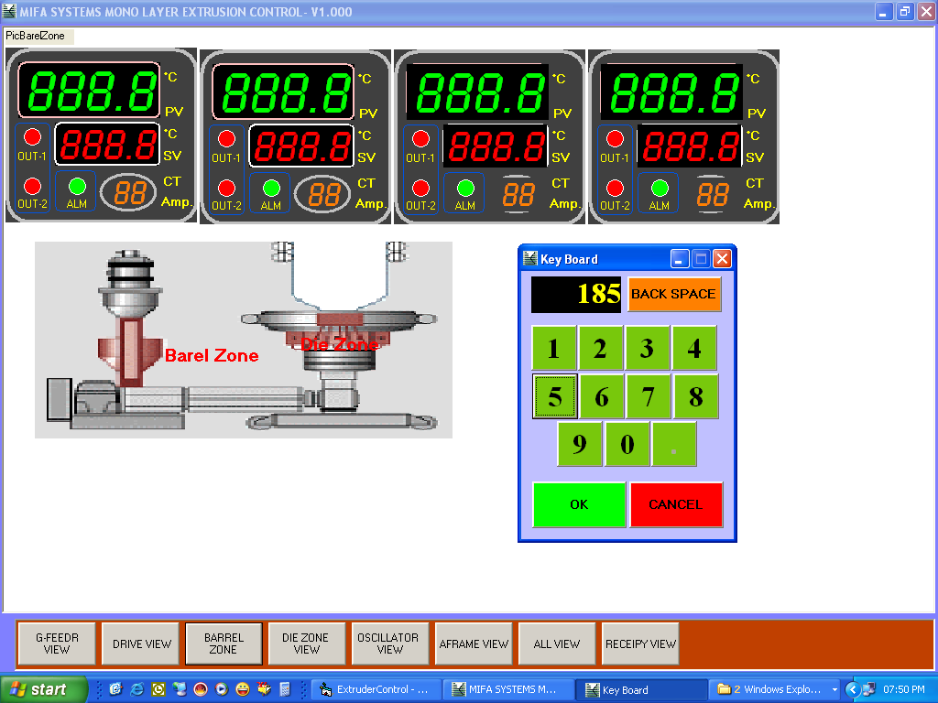
Barrel Zones

Slide 31
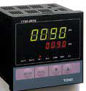




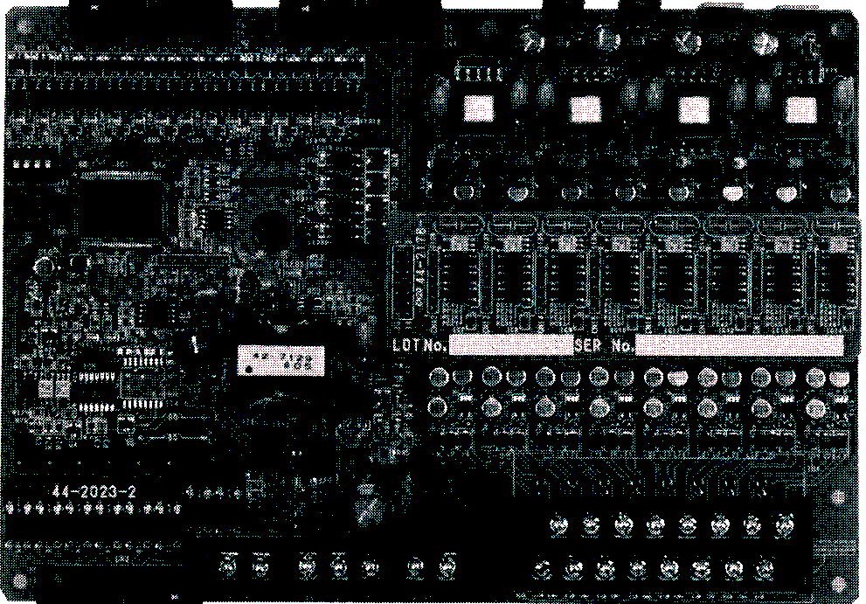
Normal PID Controllers
Various Sizes
Multi Channel Controller

Slide 32
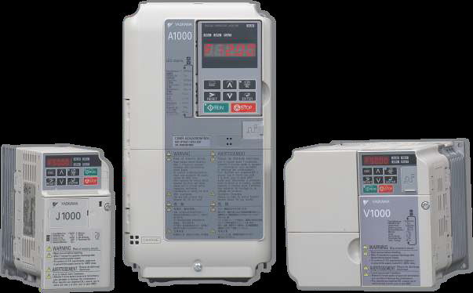
AC Drives
Very useful tool for energy saving and protection of motor and mechanics.

Slide 33
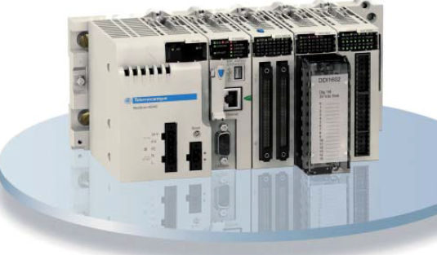
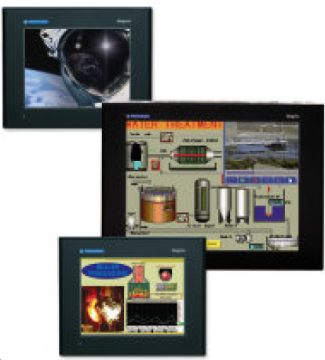
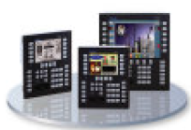
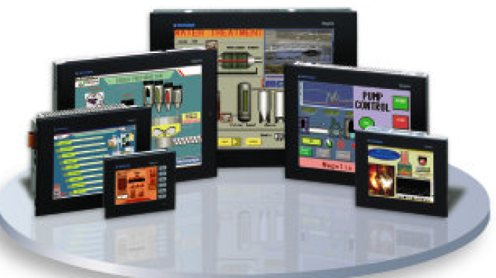
PLC’s & HMI
Various PLC & HMI are available as per requirements and Budgets.

Slide 34
BIG THANK YOU TO YOU ALL FOR YOUR PATIENCE & TIME
MIFA TEAM

